Slide 1

CS 7081 Advanced Algorithms
Extending Page Rank to Rank Entities That Are Not Directly Related
Final Project
Team 01
Christopher Broderick,
Rohit Dureja,
Akash Mohapatra,
Bill Nicholson,
Asrith Singa Reddy.
[1]

Slide 2

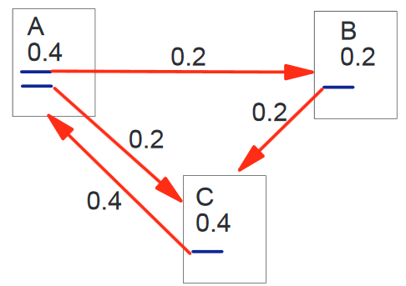
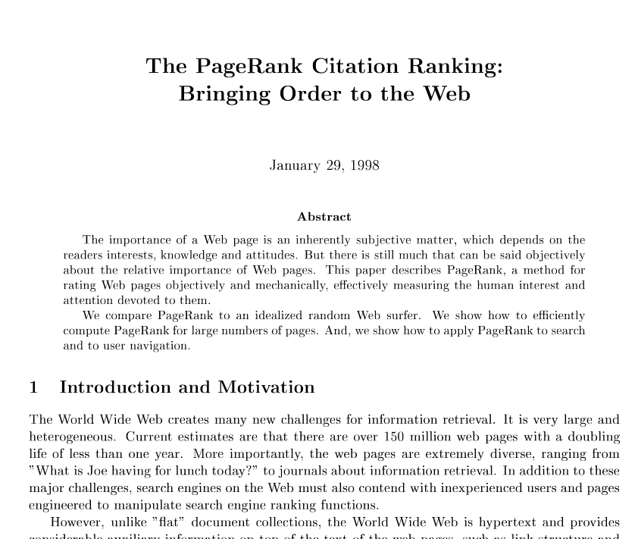
Page Rank
[2,7]

Slide 3

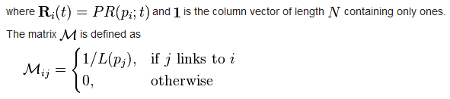
Page Rank: compute the ranking vector

Slide 4
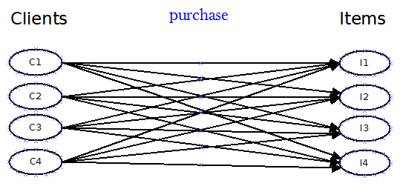
Apply Page Rank to this…
In this example, every client has purchased every Item
Bipartite Unweighted Directed Graph
These ‘links’ are organic: clients link to items by purchasing them.
There are no edges from Items to Clients!

Slide 5
Transition Matrix from Previous Slide
 | I1 | I2 | I3 | I4 | C1 | C2 | C3 | C4
I1 | 0 | 0 | 0 | 0 | 1./4 | 1./4 | 1./4 | 1./4
I2 | 0 | 0 | 0 | 0 | 1./4 | 1./4 | 1./4 | 1./4
I3 | 0 | 0 | 0 | 0 | 1./4 | 1./4 | 1./4 | 1./4
I4 | 0 | 0 | 0 | 0 | 1./4 | 1./4 | 1./4 | 1./4
C1 | 0 | 0 | 0 | 0 | 0 | 0 | 0 | 0
C2 | 0 | 0 | 0 | 0 | 0 | 0 | 0 | 0
C3 | 0 | 0 | 0 | 0 | 0 | 0 | 0 | 0
C4 | 0 | 0 | 0 | 0 | 0 | 0 | 0 | 0
[6]

Slide 6
Compute the ranking vector
After 20 iterations: final state of the Ranking Vector:
I1 0.12219
I2 0.12219
I3 0.12219
I4 0.12219
C1 0.10625
C2 0.10625
C3 0.10625
C4 0.10625
(Damping Factor of .85 allows the unlinked nodes to earn a non-zero ranking)

Slide 7
We need weights
Google’s Page Rank (probably) doesn’t use weights.
We can add weights to our domain
What if Client C1 buys 10 of Item I1?

Slide 8
Client C1 Buys 10 of Item I1
 | I1 | I2 | I3 | I4 | C1 | C2 | C3 | C4
I1 | 0 | 0 | 0 | 0 | 10./13 | 0.25 | 0.25 | 0.25
I2 | 0 | 0 | 0 | 0 | 1./13 | 0.25 | 0.25 | 0.25
I3 | 0 | 0 | 0 | 0 | 1./13 | 0.25 | 0.25 | 0.25
I4 | 0 | 0 | 0 | 0 | 1./13 | 0.25 | 0.25 | 0.25
C1 | 0 | 0 | 0 | 0 | 0 | 0 | 0 | 0
C2 | 0 | 0 | 0 | 0 | 0 | 0 | 0 | 0
C3 | 0 | 0 | 0 | 0 | 0 | 0 | 0 | 0
C4 | 0 | 0 | 0 | 0 | 0 | 0 | 0 | 0
Computed Ranking vector:
I1 0.13046
I2 0.11943
I3 0.11943
I4 0.11943
C1 0.10625
C2 0.10625
C3 0.10625
C4 0.10625
This still generates uniform ranks
for all Clients because the damping factor is the only way we traverse client nodes.

Slide 9
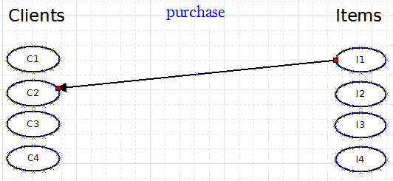

For Page Rank to work: we need directed edges from Items to Clients
There is no organic link from Item to Client
Items do not ‘vote for’ Clients
!
[5]

Slide 10

There are ways to add edges…
Link Item back to Clients that purchased that item.
Weighted by (cost of the item X quantity)
Cost X Quantity
[4]

Slide 11
Results
 |  | Qty Purchased |  |  |  |  |  | Weighted Amount |  |  |  |  | total clients that purchased this item | total qty purchased
Item | Cost (weight) | C1 | C2 | C3 | C4 | Total |  | C1 | C2 | C3 | C4
I1 | $ 1.00 | 10 | 1 | 1 | 0 | 12 |  | 10 | 1 | 1 | 0 | 12 | 3 | 12
I2 | $ 2.00 | 1 | 1 | 0 | 1 | 3 |  | 2 | 2 | 0 | 2 | 6 | 3 | 3
I3 | $ 3.00 | 1 | 0 | 1 | 1 | 3 |  | 3 | 0 | 3 | 3 | 9 | 3 | 3
I4 | $ 4.00 | 0 | 1 | 1 | 1 | 3 |  | 0 | 4 | 4 | 4 | 12 | 3 | 3
Computed Ranking vector:
I1 0.13554
I2 0.12149
I3 0.12149
I4 0.12149
C1 0.13534
C2 0.12009
C3 0.12009
C4 0.12447
 | I1 | I2 | I3 | I4 | C1 | C2 | C3 | C4
I1 | 0 | 0 | 0 | 0 | 10./13 | 1./4 | 1./4 | 1./4
I2 | 0 | 0 | 0 | 0 | 1./13 | 1./4 | 1./4 | 1./4
I3 | 0 | 0 | 0 | 0 | 1./13 | 1./4 | 1./4 | 1./4
I4 | 0 | 0 | 0 | 0 | 1./13 | 1./4 | 1./4 | 1./4
C1 | 10./12 | 2./6 | 3./9 | 0 | 0 | 0 | 0 | 0
C2 | 1./12 | 2./6 | 0 | 4./12 | 0 | 0 | 0 | 0
C3 | 1./12 | 0 | 3./9 | 4./12 | 0 | 0 | 0 | 0
C4 | 0 | 2./6 | 3./9 | 4./12 | 0 | 0 | 0 | 0

Slide 12
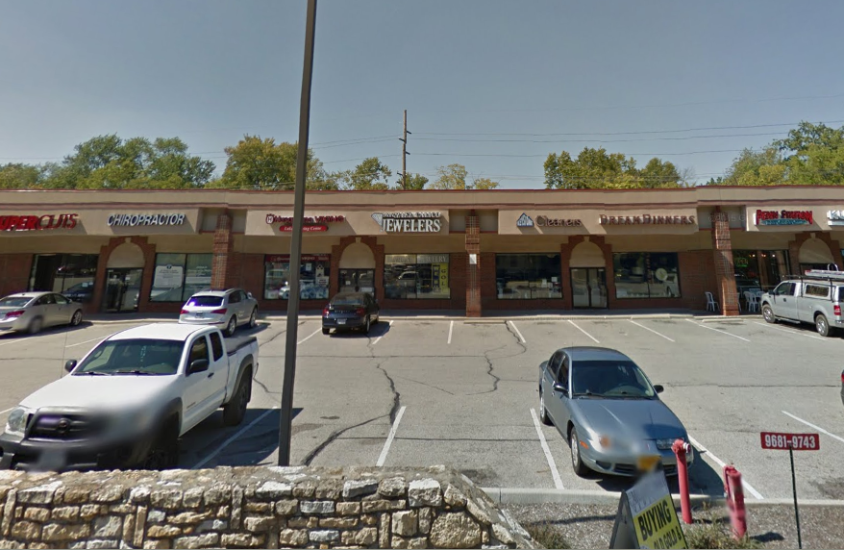
Real-World Data
73 Items
26 Clients
134 Transactions
99 X 99 Transition Matrix (too big for a slide)

Slide 13
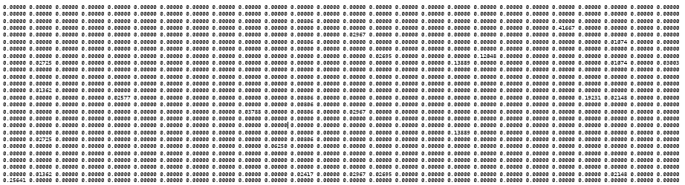
Real-World Data
99 X 99 Transition Matrix (too big for a slide)

Slide 14
Ranking Vector for 26 Clients, 78 Items
0.008589
0.008586
0.008609
0.008640
0.008591
0.008589
0.008587
0.008618
0.008623
0.008586
0.008586
0.008586
0.008642
0.008635
0.008594
0.008600
0.008597
0.008587
0.008604
0.008594
0.008594
0.008596
0.008586
0.008586
0.008626
0.008635
0.008603
0.008594
0.008586
0.008586
0.008587
0.008586
0.008586
0.008586
0.008586
0.008593
0.008596
0.008593
0.008586
0.008598
0.008595
0.008586
0.008586
0.008586
0.008600
0.008586
0.008586
0.008591
0.008593
0.008595
0.008586
0.008587
0.008589
0.008586
0.008586
0.008586
0.008593
0.008592
0.008589
0.008586
0.008586
0.008586
0.008586
0.008589
0.008586
0.008594
0.008586
0.008609
0.008593
0.008586
0.008616
0.008586
0.008586
0.008586
0.008586
0.008588
0.008586
0.008586
0.008591
0.008594
0.008586
0.008586
0.008586
0.008602
0.008595
0.008586
0.008586
0.008596
0.008586
0.008586
0.008586
0.008586
0.008586
0.008586
0.008586
0.008586
0.008586
0.008586
0.008586

Slide 15
Real-World Results

Slide 16
How did we do?
 | Last Name | First Name | Amount Spent | Items Purchased
C1 | Messink | Carol | 5702.56 | 4
C2 | Barrett | Bernard | 5105.11 | 6
C3 | Bryant | Marie | 4136.66 | 19
C4 | Peterson | Rose | 3000 | 1
C5 | Gorman | Donna | 1504.92 | 5
C6 | Hite | Joanne | 1435.8 | 12
C7 | Cobbins | Steve | 1174.54 | 5
C8 | Hinson | Daphne | 1163.05 | 11
C9 | Stobbe | Travis | 1149.5 | 7
C10 | Sanders | Jill | 1126.81 | 7
C11 | Hodge | Bruce | 1031 | 6
C12 | Miller | Larry | 983.96 | 9
C13 | Turner | Perry | 552.5 | 5
C14 | Merida | Billie | 420.65 | 14
C15 | Sapadin | Helen | 315 | 2
C16 | Gholston | Carmen | 220 | 2
C17 | Tarter | Denny | 181.95 | 3
C18 | Berry | Elana | 160 | 2
C19 | Tillar | R | 158 | 1
C20 | Hacker | Don | 133.5 | 2
C21 | Mullen | Kathy | 87.48 | 2
C22 | Walker | Rick | 45 | 1
C23 | Reisert | James | 35 | 1
C24 | Jones | Loretta | 34 | 1
C25 | Broach | Michael | 27.95 | 3
C26 | Wilburn | Louise | 0 | 1
Our ranking algorithm
selected a client in the middle,
when ordered by total amount spent.

Slide 17
How else did we do?
 | Last Name | First Name | Amount Spent | Items Purchased
C1 | Peterson | Rose | 3000 | 1
C2 | Tillar | R | 158 | 1
C3 | Walker | Rick | 45 | 1
C4 | Reisert | James | 35 | 1
C5 | Jones | Loretta | 34 | 1
C6 | Wilburn | Louise | 0 | 1
C7 | Sapadin | Helen | 315 | 2
C8 | Gholston | Carmen | 220 | 2
C9 | Berry | Elana | 160 | 2
C10 | Hacker | Don | 133.5 | 2
C11 | Mullen | Kathy | 87.48 | 2
C12 | Tarter | Denny | 181.95 | 3
C13 | Broach | Michael | 27.95 | 3
C14 | Messink | Carol | 5702.56 | 4
C15 | Gorman | Donna | 1504.92 | 5
C16 | Cobbins | Steve | 1174.54 | 5
C17 | Turner | Perry | 552.5 | 5
C18 | Barrett | Bernard | 5105.11 | 6
C19 | Hodge | Bruce | 1031 | 6
C20 | Stobbe | Travis | 1149.5 | 7
C21 | Sanders | Jill | 1126.81 | 7
C22 | Miller | Larry | 983.96 | 9
C23 | Hinson | Daphne | 1163.05 | 11
C24 | Hite | Joanne | 1435.8 | 12
C25 | Merida | Billie | 420.65 | 14
C26 | Bryant | Marie | 4136.66 | 19
Ordered by total items purchased.

Slide 18
Future Work
Experiment with different weights such as # of purchases and dates.

Slide 19
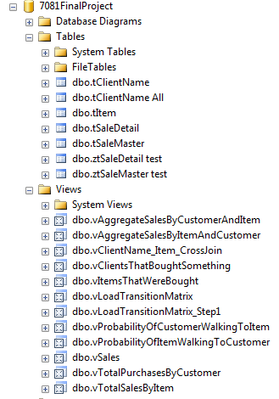
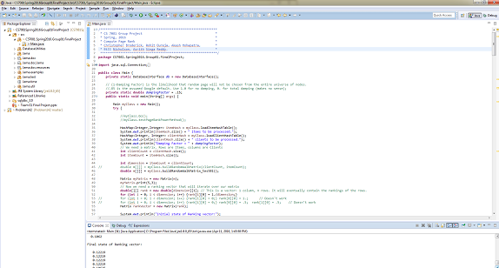
Tools
Code and presentation available at https://github.com/nicomp42/CS7081Spring2016Group01FinalProject

Slide 20
References
[1] Search.Dilbert.com
[2] Page, Lawrence, et al. "The PageRank citation ranking: bringing order to the web." (1999).
[3] http://www.ams.org/samplings/feature-column/fcarc-pagerank
[4] https://en.wikipedia.org/wiki/PageRank
[4] YouTube.com
[5] www.beanstalkim.com\
[6] "MS&E 233 Lecture 8: Applications of PageRank to Recommendation Systems." MS&E 233 Lecture 8: Applications of PageRank to Recommendation Systems. Ed. Ashish Goel. Stanford University. Web. 13 Apr. 2016.
[7] Google.com
[8] https://www.google.com/maps/uv?hl=en&pb=!1s0x884053a2f4f6d27b:0x1f562855bf86f422!2m5!2m2!1i80!2i80!3m1!2i100!3m1!7e115!4s/maps/place/michael%2Bcalico%2Bjeweler/@39.2347543,-84.3766656,3a,75y,266.11h,90t/data%3D*213m4*211e1*213m2*211sNDikPhdOG_APjUXjirrC3A*212e0*214m2*213m1*211s0x0:0x1f562855bf86f422!5smichael+calico+jeweler+-+Google+Search&imagekey=!1e2!2sNDikPhdOG_APjUXjirrC3A&sa=X&ved=0ahUKEwi4hbDMyJDMAhXJ2xoKHeO0CUYQpx8IfjAO
Code and presentation available at https://github.com/nicomp42/CS7081Spring2016Group01FinalProject

